Slide 1



Benefits
Overview
2026

Slide 2
Open Enrollment
Annual Opportunity to Add, Change, Drop or Waive Coverage
This is an ACTIVE Open Enrollment
Changes go into effect on: 1/1/2026
Mid-year elections or changes require a qualified life event
Open Enrollment begins on November 6th.

Slide 3







2026 Benefit Offerings
Medical – WPS/Auxiant
FSA – Employee Benefits Corporation
Dental – Delta Dental of Wisconsin
Vision – Delta Dental of Wisconsin (DeltaVision)
Life/AD&D, LTD, STD – Lincoln Financial Group
Voluntary Benefits – Lincoln Financial Group
Pet Insurance – Spot Pet
Employee Assistance Program (EAP) – Emplify Health by Gundersen

Slide 4


Medical Plan Option 1: Copay Plan
Copay Plan | In-Network Benefits | Out-of-Network Benefits
Deductible | $1,000 $2,000 | $2,000 $4,000
Coinsurance | 80% | 50%
Out of Pocket Maximum* | $2,000 $4,000 | $8,000 $16,000
Hosp/Surg/Lab/X-Ray | Deductible/Coinsurance | Deductible & Coinsurance
Preventive Exams | Covered 100% | Deductible & Coinsurance
PCP Visits | $20 Copay | Deductible & Coinsurance
Specialist Visit | $40 Copay | Deductible & Coinsurance
Urgent Care | $120 Copay | Deductible & Coinsurance
Emergency Room | $350 Copay
Prescription Drugs | $10 / $35 / $60 / $200 | Deductible & Coinsurance

Slide 5

Medical Plan Premiums
Copay Plan
Hours Worked Prior Quarter | Per Pay Period Rate (Single) | Per Pay Period Rate (Single + 1) | Per Pay Period Rate (Family)
0 – 52 | $438.50 | $833.15 | $1,154.48
54 – 58 | $177.59 | $366.59 | $507.97
60 – 68 | $140.32 | $299.93 | $415.61
70 – 78 | $65.78 | $166.63 | $230.90
80 + | $58.32 | $153.30 | $212.42

Slide 6
Medical Plan Option 2: HDHP
Copay Plan | In-Network Benefits | Out-of-Network Benefits
Deductible | $2,000 $4,000 | $4,000 $8,000
Coinsurance | 80% | 50%
Out of Pocket Maximum* | $4,000 $8,000 | $8,000 $16,000
Hosp/Surg/Lab/X-Ray | Deductible/Coinsurance | Deductible & Coinsurance
Preventive Exams | Covered 100% | Deductible & Coinsurance
PCP Visits | Deductible & Coinsurance | Deductible & Coinsurance
Specialist Visit | Deductible & Coinsurance | Deductible & Coinsurance
Urgent Care | Deductible & Coinsurance | Deductible & Coinsurance
Emergency Room | Deductible & Coinsurance
Prescription Drugs | Deductible, then $10 / $35 / $60 / $200 | Deductible & Coinsurance

Slide 7
Medical Plan Premiums
High Deductible Health Plan
Hours Worked Prior Quarter | Per Pay Period Rate (Single) | Per Pay Period Rate (Single + 1) | Per Pay Period Rate (Family)
0 – 52 | $392.32 | $745.41 | $1,036.62
54 – 58 | $158.89 | $327.98 | $456.11
60 – 68 | $125.54 | $268.35 | $373.18
70 – 78 | $58.85 | $149.08 | $207.32
80 + | $52.18 | $137.16 | $190.74

Slide 8
Employee Group Health Benefits

Slide 9
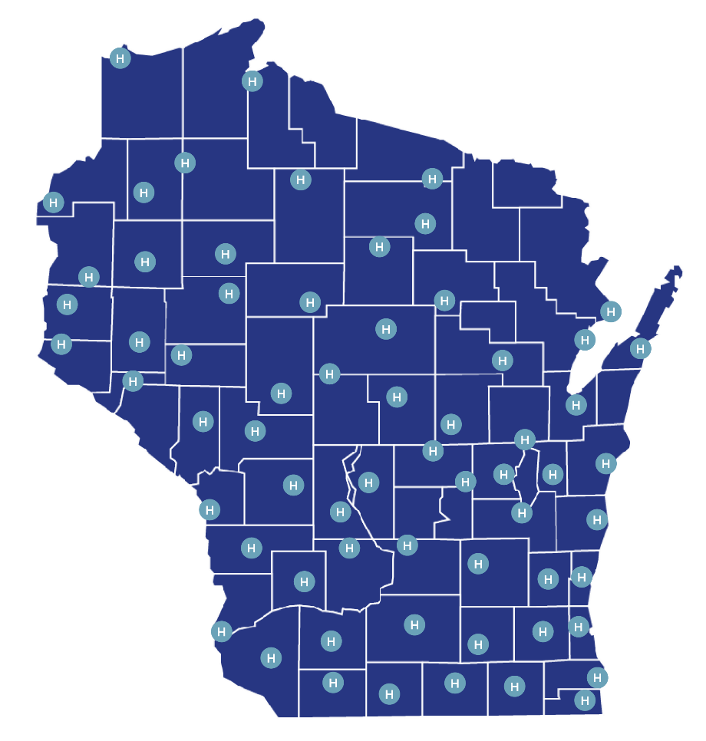

WPS Statewide Network
In Wisconsin: Convenient access to more than 65,000+ doctors and practitioners and 200+ hospitals and surgery centers throughout the state.
Ascension Wisconsin (i.e., Wheaton, CSM, Affinity, Ministry)
Aspirus Network, Inc.
Aurora Health Care
Bellin Health
Children’s Hospital of Wisconsin
Essentia Health
Froedtert Health
Medical College of Wisconsin/Children's Specialty Group
Gundersen Health System
Holy Family Memorial/Froedtert Manitowoc Medical Group
Marshfield Clinic
Mayo Clinic Health System
Oakleaf Medical Network
Hospital Sisters Health System/ Prevea Health
ProHealth
SSM Health (SSM Health Dean Medical Group/SSM Health St. Mary's Hospital)
ThedaCare
University of Wisconsin Hospital and Clinics

Slide 10
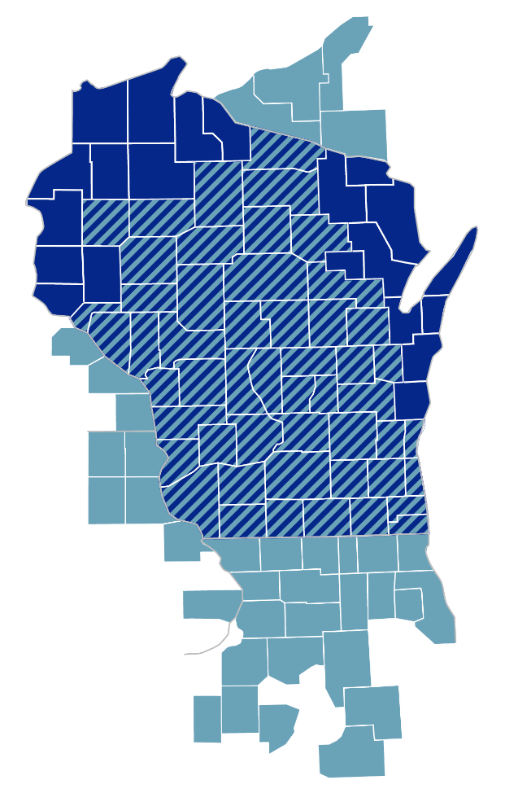

The Alliance Comprehensive Network integrated with the WPS Statewide Network
You can choose health care throughout areas of Wisconsin, including the following providers and systems:
The Alliance Comprehensive Network
Ascension Wisconsin
Aspirus Clinics: Wisconsin and Michigan
Dean/SSM Health/St. Mary’s
Gundersen Health System
Marshfield Clinic/MCHA Hospital
ProHealth Care
UnityPoint Health—Meriter
University of Wisconsin Hospitals and Clinics
WPS Statewide Network
Aurora Health Care
Bellin Health Partners
Children’s Hospital of Wisconsin
Froedtert Hospital
Mayo Clinic Health System
Medical College of Wisconsin
ThedaCare Physicians
Provider listing subject to change. For the most up-to-date and complete listing of providers, log on to the Alliance website at the-alliance.org and click on Find a Doctor. Providers can leave or enter the network at any time. It is recommended that you check the network status of your provider on a regular basis.

Slide 11

Staying healthy starts here.
Preventive care
Coordinated, preventive health care—including annual physical exams, screenings, and immunizations—is the key to wellness.
Routine immunizations
Routine medical exams
Well-child care
Mammograms
Preventive screenings
Preventive drugs
Smoking cessation program

Slide 12

Your health, your way.
24/7/365 access to general medical doctors Consult with licensed physicians anytime, anywhere.
Convenient care Receive virtual care for non-emergency conditions, prescriptions and more.
Mental health support Access counseling and therapy for stress, anxiety and more. Appointments for mental health services available between 7 am - 9 pm local time.
Dermatology support Get a diagnosis and treatment for skin issues within 24 hours.
Cost savings Affordable care with no need for in-person visits.

Slide 13

Active&FitTM Direct fitness program.
Choose from 12,700+ fitness centers and 9,800+ premium studios nationwide.
Access 14,000+ on-demand workouts from home or on the go.
$28 a month plus a one-time $28 enrollment fee and applicable taxes.
No long-term contracts—just a 2-month initial commitment, then month-to-month with the freedom to cancel anytime.*
For more information visit activeandfitdirect.com/faq
The Active&Fit Direct program is provided by American Specialty Health Fitness, Inc., a subsidiary of American Specialty Health Incorporated (ASH). Active&Fit Direct is a trademark of ASH. Fitness program is not part of the insurance policy and is offered at no additional charge. This program is subject to contract renewal and can be changed or discontinued at any time. *If you cancel your membership and enroll in a new membership you will need to pay the $28 enrollment fee again.

Slide 14

Smoking Cessation Program
Helps you quit for free.
Offers access to certain nicotine replacements and drugs used to help you overcome tobacco addiction.
Eligibility requirements:
18 years of age or older.
Have a prescription written by a doctor, even for over-the-counter products.
Fill the prescription at an in-network pharmacy.
Please contact your physician or health care provider with any medical questions and to obtain a prescription.

Slide 15

Use your tools.
Search for in-network providers. Use our Find a Doctor provider search tool to find in-network care near you. In-network doctors and facilities cost less because they’ve agreed to discounted rates with your plan.
Create a WPS customer account. Visit wpshealth.com/group and register for a WPS customer account. You can easily view your benefits, check claims and cost and access other helpful tools.
Save WPS Customer Service phone number in your phone. Keep your insurance card handy and save the customer service number listed on our ID card in your phone.
Notes:
Use the tools available to you. Find in-network providers, register for your WPS account and set up your Teladoc Health account so you are ready when care is needed. Keep the WPS customer service number handy. You can find it on the back of your WPS ID card.

Slide 16

How to Contact Customer Service
If you need additional help or don’t have internet access, please call the Customer Service number listed on your customer ID card Monday through Friday, 7:30 a.m. to 5 p.m.
You can reach Customer Service by secure message through your online Customer account.

Slide 17
Thank you!

Slide 18


Slide 19
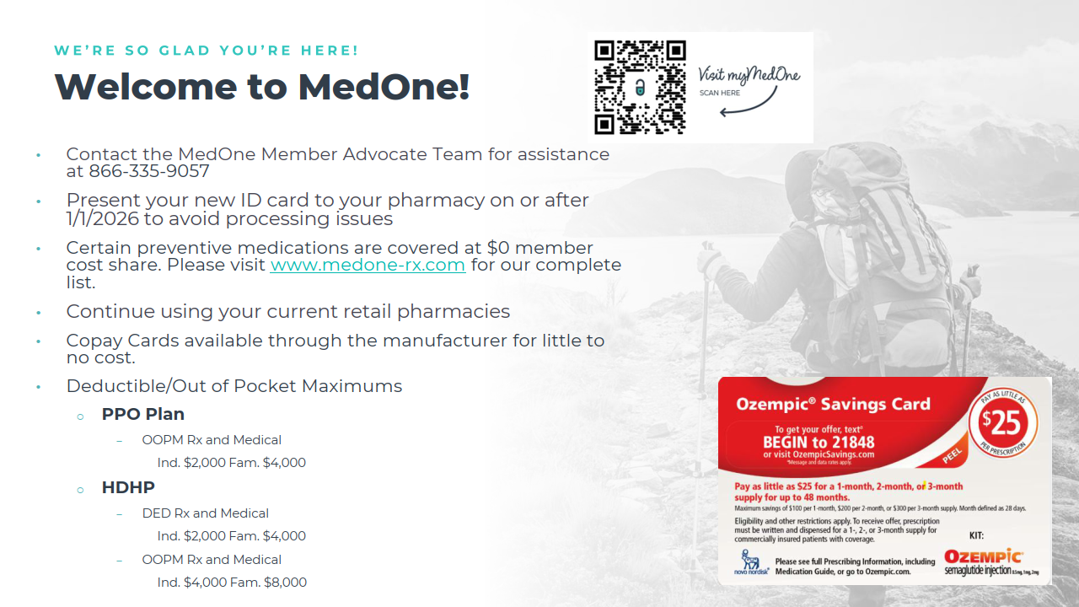

Slide 20
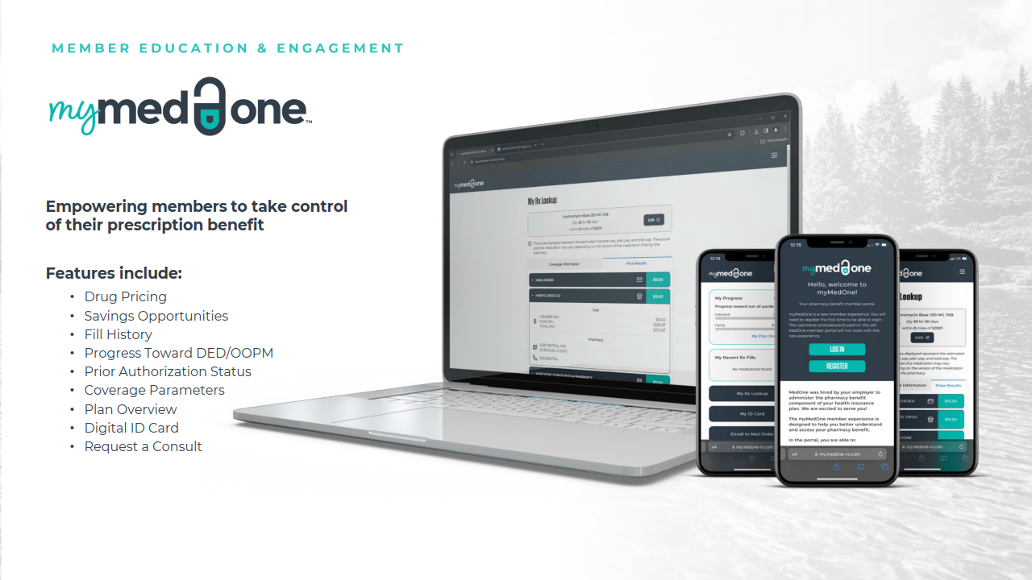

Slide 21
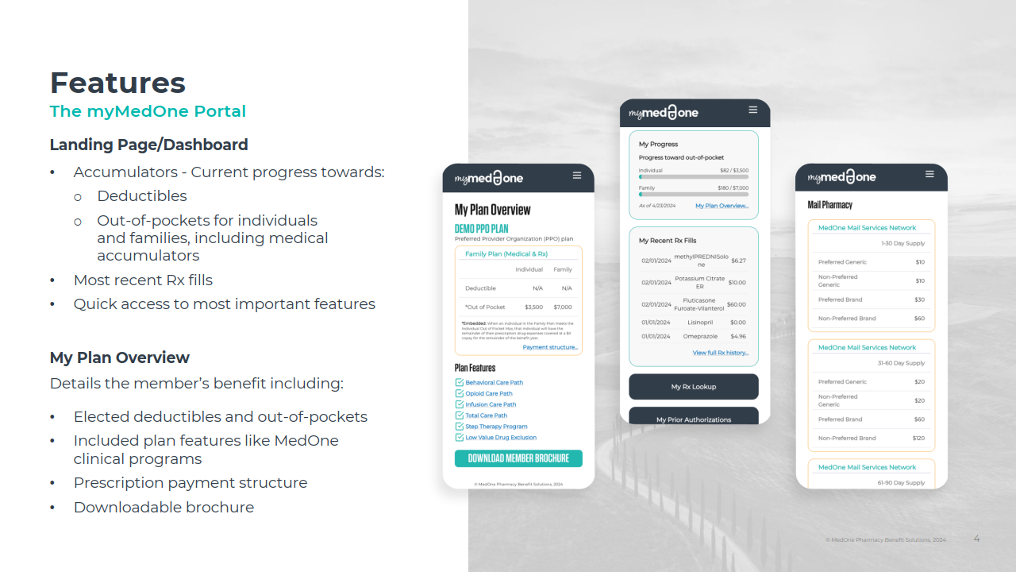

Slide 22
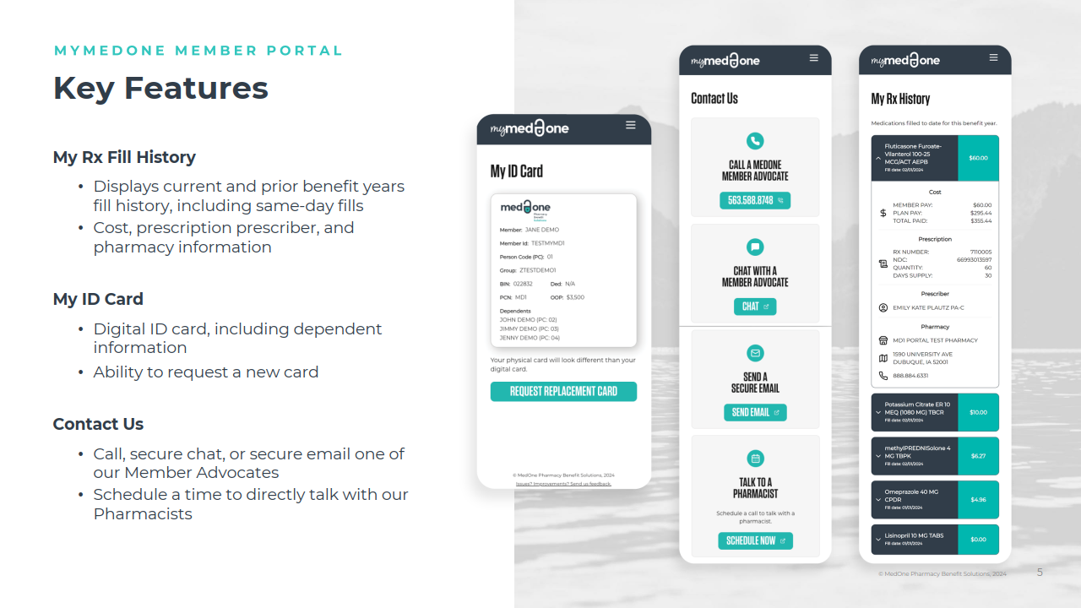

Slide 23
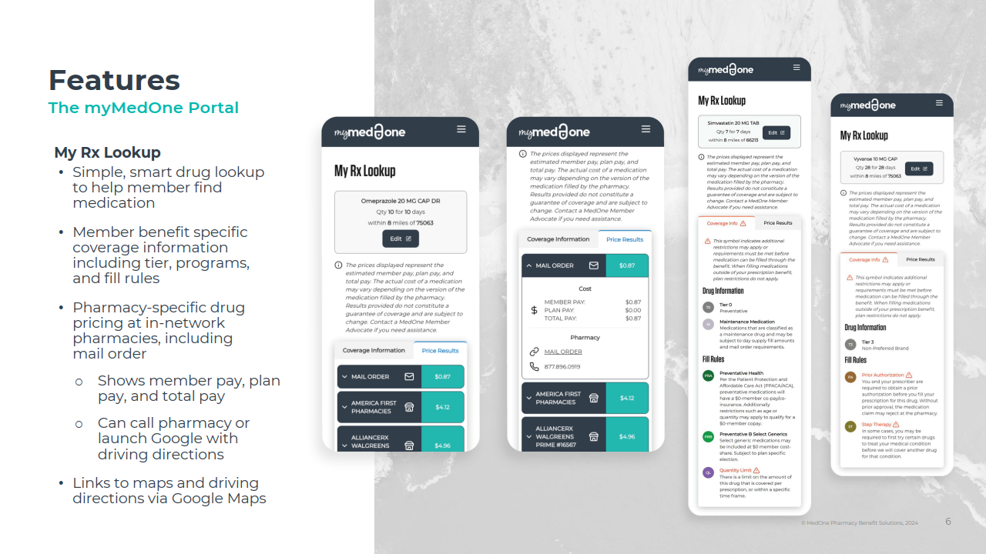

Slide 24
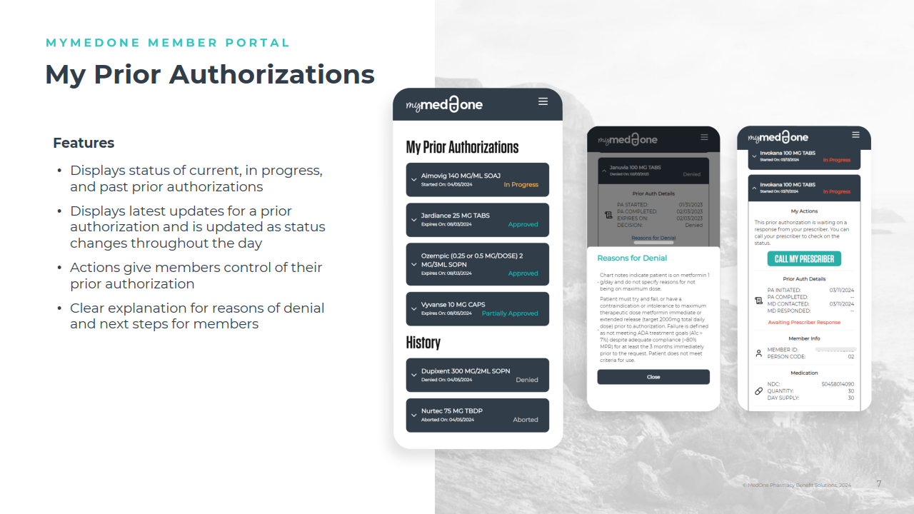

Slide 25
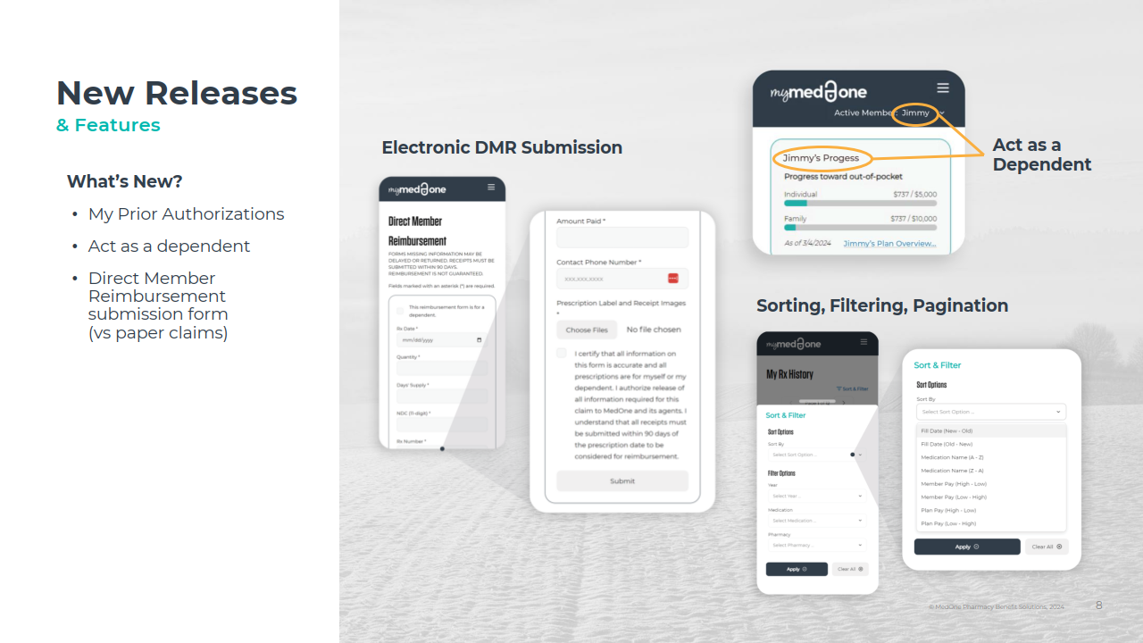

Slide 26
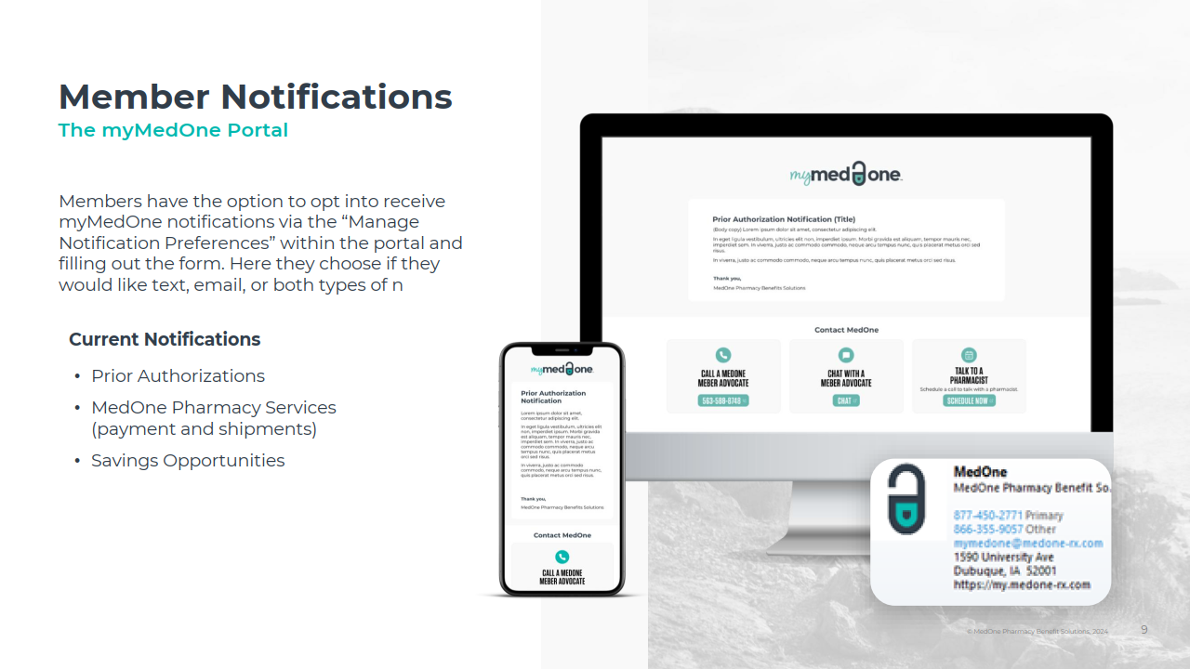

Slide 27
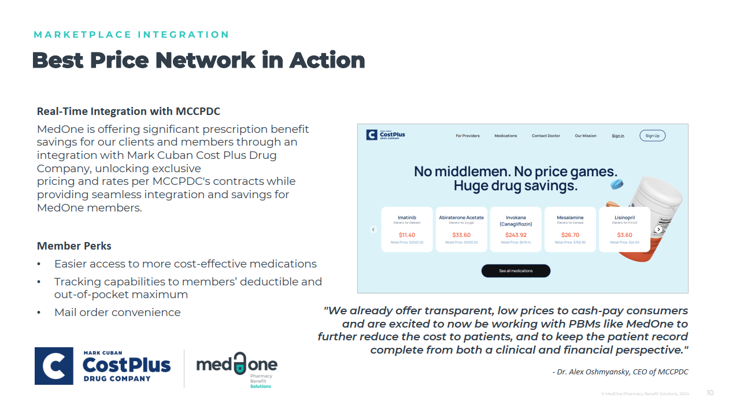

Slide 28
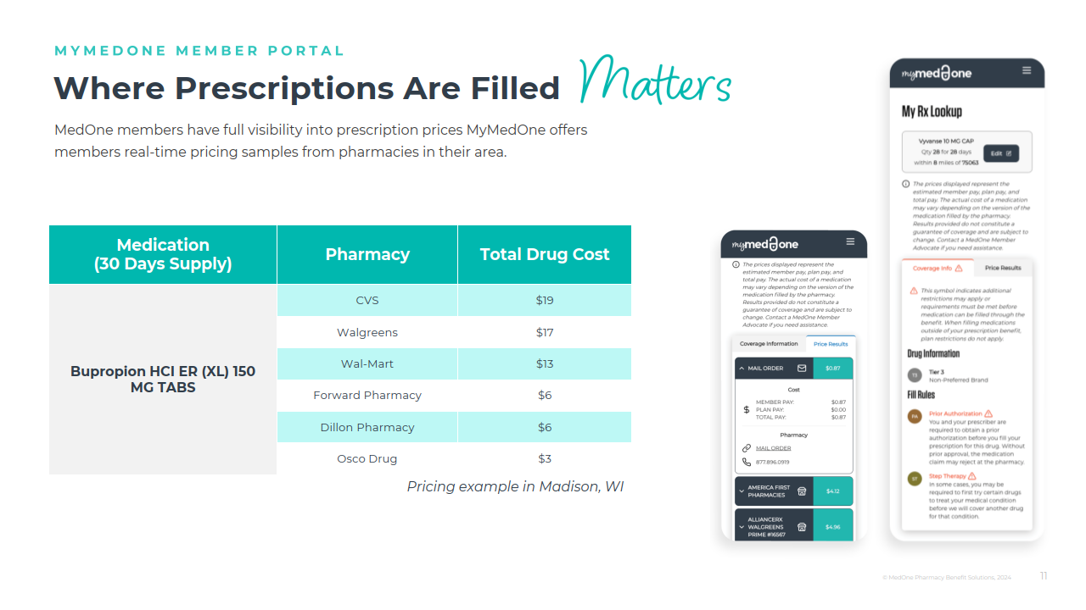

Slide 29
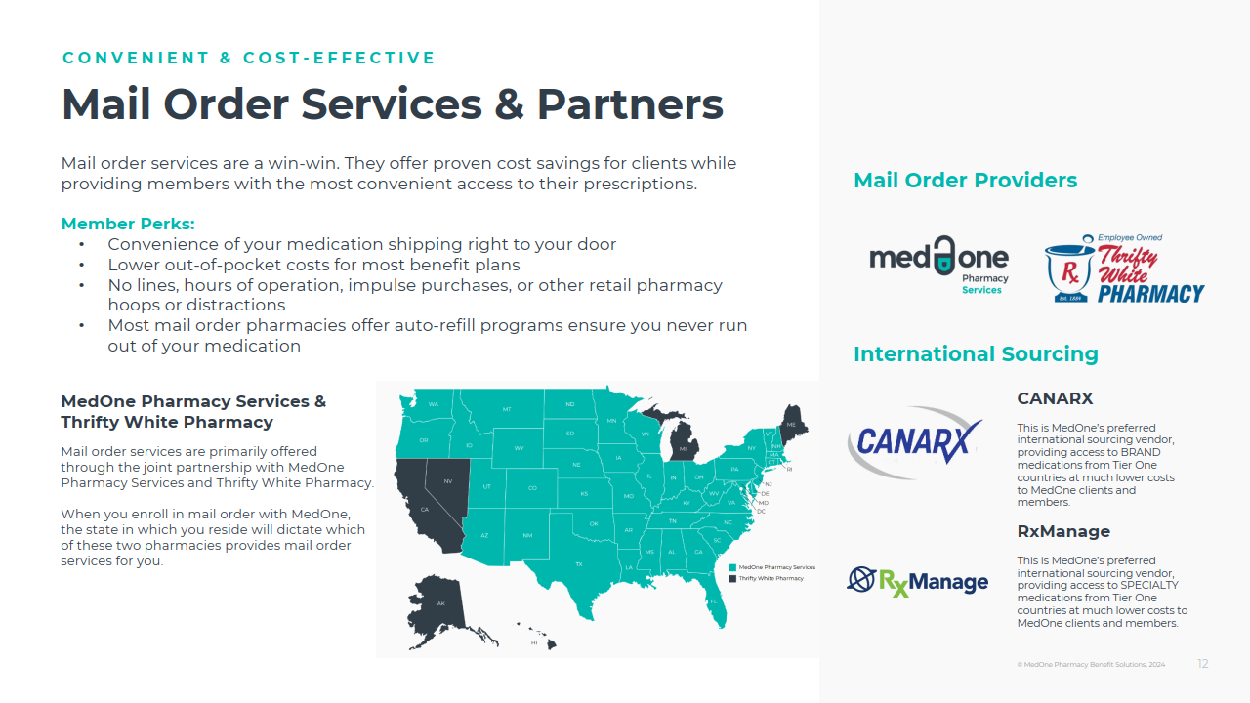

Slide 30
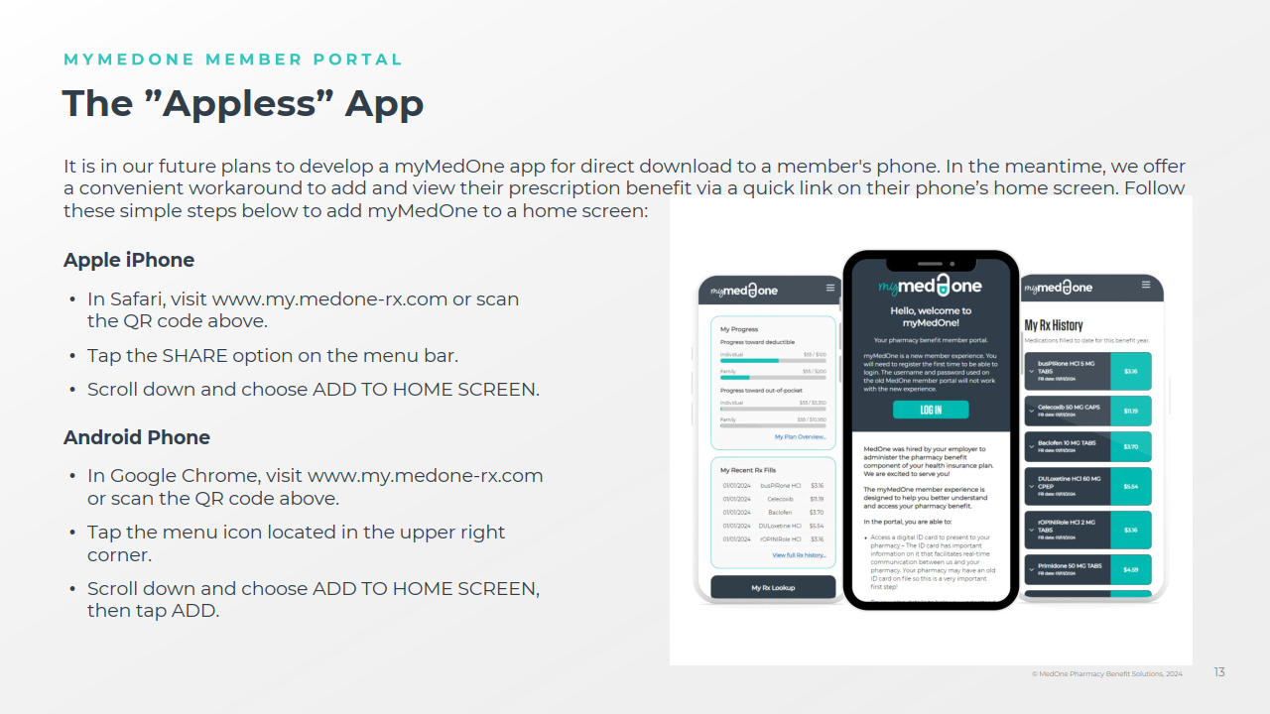

Slide 31


Slide 32
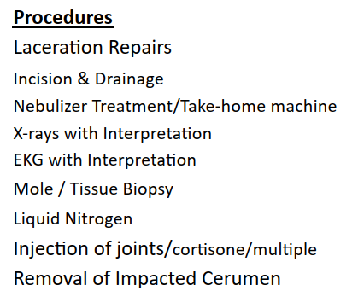
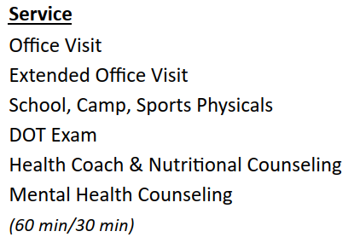
The Neighborhood Clinic Partnership
New this year, Bethany St. Joseph is partnering with The Neighborhood Clinic for employees, enrolled in the BSJ health plan, to visit for various services at no cost to you. Below are some of the clinics services but not limited to.

Slide 33

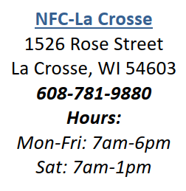

The Neighborhood Clinic - Locations

Slide 34


Health Savings Account
Portable account - No ‘Use it or lose it’
Entire Balance Rolls year to year
Retirement income: can act as an IRA, withdraw at age 65 (normal taxes apply)
Notes:
Your HSA is in your name, belongs to you and is portable. There is no “use it or lose it” and any unused funds can be rolled forward. Once you reach age 65, if you still have money in your HSA, you can enjoy some additional retirement income.

Slide 35

Health Savings Account
HSA TRIPLE TAX ADVANTAGE :
Tax free contributions
Tax free interest
Tax free withdrawals for qualified expenses
Non-qualified: penalty + income tax
Max contributions are $4,400 for Single / $8,750 for Family for 2026. Add $1,000 to totals if over age 55
Notes:
You may open an HSA (Health Savings Account) through Associated Bank.
There is a triple tax advantage to your HSA: any contributions you make are tax free and can be made thru pre-tax payroll deductions.
HSAs accrue tax free interest, and any withdrawals made for qualified medical, dental, and vision expenses are also tax free.
If you use HSA money for non-qualified expenses, you will pay penalties and income taxes, therefore this isn’t advisable.
There are also maximum contributions each year for single/family coverage, which are shown here.

Slide 36
Flexible Spending Account
You have the opportunity to save pre-tax money on your healthcare by participating in the Flexible Spending Account (FSA) that Bethany St. Joseph offers.
IMPORTANT!
You must use the funds in your FSA prior to the end of the plan year.
The plan will allow you to rollover $680 into the following plan year.
Runout Period is 3 months long.
Unused funds will be forfeited!
General Purpose FSA
Medical, Dental & Vision Expenses – Your FSA dollars can be used for office visits, services, and materials. Enrolling in the general-purpose FSA will make you and/or your spouse ineligible to contribute to an HSA.
Dependent Care FSA
Use Tax Free Dollars for dependent care expenses.
2025 Annual IRS Contribution Limit:
Health Care General Purpose | $3,400
Dependent Care FSA | $7,500

Slide 37
FSA vs. HSA
Both allow you to put TAX-FREE money aside out of your paycheck!
FSA | HSA
Traditional copay plans | HDHP/HSA eligible plan
Medical/dental/vision expenses | Medical/dental/vision expenses
Funds all available on day one | Funds available as deposited
Changes only with qualified life event | Can change elections as needed
“Use it or Lose it” | Money carries forward… retirement
Not portable | Portable
No interest | Earns tax-free interest
Annual maximum $3,200 | Annual maximum $4,400/$8,750 plus $1,000 catch up 55+
Notes:
Here is list of all similarities and differences between HSAs and FSAs. As a reminder, please note that if you choose a traditional copay plan, you will have access to the FSA. If you choose a High Deductible Health Plan that is HSA eligible, you will be able to enroll in a Health Saving Account.
Please keep in mind, that if you are not currently enrolled in the FSA.
The IRS determines the eligibility, rules and tax implications of how both of these plans operate.
They can both be used to put tax-free money aside out of your paycheck for medical, dental and vision expenses. With the HSA, you can use the funds as they are deposited, and you can make changes to your election amount any time throughout the year.
With FSAs the annual amount is all available on day one of the plan and you are locked into the amount you choose for the year unless you have a qualifying life event. All money in your HSA belongs to you, the account is portable if you leave the company, and any unused funds carry over year each and can be used in the future for retirement. HSAs can even earn tax free interest!! FSAs are not portable and all the funds you allocate must be used within THAT plan year or they are forfeited. The maximum contribution amounts for both HSAs and FSAs differ as well and are provided here for your reference.

Slide 38

Dental Plan
Benefits | Delta Dental Premier Network
Deductible (single/family) | $50/$150
Annual Benefit Maximum | $1,000
Preventive Services | 100% Covered
Basic Services | 80% after Deductible
Major Services | 50% after Deductible
Orthodontic Services Adults & Children | 50% up to $1,500 lifetime benefit maximum

Slide 39

Dental Plan Premiums
Dental Plan
Hours Worked Prior Quarter | Per Pay Period Rate (Single) | Per Pay Period Rate (Family)
0 – 52.99 | $15.83 | $50.46
53 – 59.99 | $8.07 | $35.62
60 – 69.99 | $6.97 | $33.51
70 – 79.99 | $4.75 | $29.27
80 + | $4.53 | $28.84

Slide 40

Vision Plan
Benefits | In-Network | Out of Network
Vision Exam (Every 12 months) | $10 copay | Up to $35 reimbursement
Frames (Every 24 months) | $130 allowance + 20% off balance | Up to $65 reimbursement
Standard Lenses (Every 12 months) | $10 copay | Up to $25 reimbursement
Contact Lenses (Every 12 months) | $120 allowance + 15% off balance | Up to $96 reimbursement

Slide 41

Vision Plan Premium
Vision Plan | Bi-Weekly Premiums
Employee | $2.73
Family | $6.80

Slide 42

Life/AD&D Insurance
Group Life/AD&D
Life/AD&D Benefit: 1x Annual Salary up to $100,000
Update Beneficiary Information
Sponsored by Bethany St. Joseph
Voluntary Life/AD&D
You have the option to purchase additional life insurance. Total costs are calculated based on your age and the amount of coverage you are requesting.

Slide 43
Disability Insurance
Voluntary Short-Term Disability (STD) - Lincoln
Benefit | 60% of your weekly income to a maximum of $1,000 per week
Elimination Period | 14 days
Benefit Duration | 24 Weeks
Premium/cost: | Voluntary – See Benefit Guide
Long Term Disability (LTD) – Lincoln
Benefit | 60% of your monthly income to a maximum of $4,333 per month
Elimination Period | 180 days
Benefit Duration | Social Security Normal Retirement Age
Premium/cost: | Paid by Bethany St. Joseph

Slide 44
Voluntary Worksite Benefits
Voluntary Accident Insurance
Your medical insurance will cover some of the expenses incurred from an accident, but you’ll be left to foot the bills for your copays and deductible. Those can add up fast, especially if you’re unable to work while you recover. That’s where accident insurance comes in. It helps protect your bank account from the out-of-pocket expenses that come with an injury, whether you’re coping with a broken arm or recovering from a serious car accident. Accidents such as Broken Bones, Torn Ligaments, Burns, Concussions, Lacerations and much more could qualify for a cash benefit under the Voluntary Accident Insurance policy.
Voluntary Critical Illness Insurance
You may have medical insurance. But that doesn’t mean you’re covered for all of the expenses resulting from a serious illness that you probably haven’t budgeted for. Things like copays, deductibles, loss of income, childcare and travel expenses. Critical Illness insurance helps fill the gap caused by these out-of-pocket costs, creating a financial safety net for you and your family. The critical illness policy provides the option to receive a lump sum cash benefit upon initial diagnosis of one the approved conditions. This plan is designed to provide financial peace of mind during times of medical distress.
Voluntary Hospital Indemnity Insurance
Hospital Indemnity insurance provides additional financial support when you need it most. This benefit will provide you with a cash reimbursement in the event you are admitted to the hospital as a result of a covered illness and/or injury. Since this benefit is paid directly to you, you are eligible to use the funds towards expenses that are not covered by your health insurance or every day living expenses!

Slide 45
Employee Assistance Program
Balancing your work and home life is not always easy, with Bethany St. Joseph's EAP program you don’t have to face life’s challenges alone.
You may be struggling with stress at work, seeking financial or legal advice, or coping with the death of a loved one. Maybe you just want to strengthen your relationship with your family. Your benefit offers assistance and support for all these concerns and more:
Depression
Marital Difficulties
Financial Concerns
Family Conflicts
Alcohol and Drug Problems
Work-Related Issues
Please call 608.775.4780 or 800.327.991
Or email eap@gundersonhealth.com

Slide 46

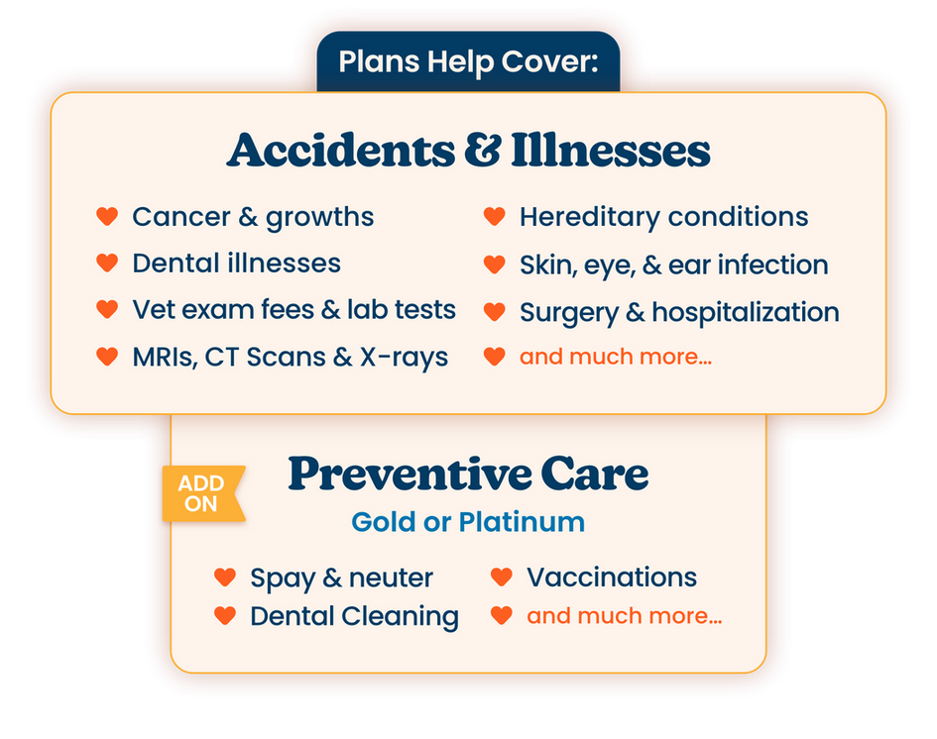


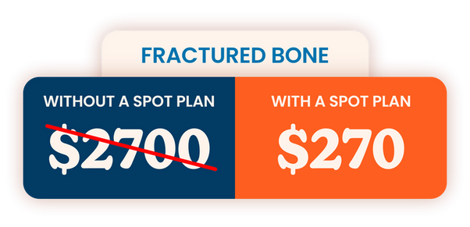




spotpet.link/bsjcorp
or call 888.343.2340
v
β “Pet Insurance Statistics 2024” Forbes Advisor, Jan 3, 2024. *Includes a 10% employee discount on every pet, plus an additional 10% multi-pet discount on all pets after the first. Employee discount not available in HI or TN.
∞ Eligibility is open to all. Based on total combined Spot Perks discounts applied to avg. vendor cart value. See spotpet.com/perks-terms. For all terms visit https://spotpet.com/sample-policy. Insurance plans are underwritten by either Independence American Insurance Company (NAIC #26581)
or United States Fire Insurance Company (NAIC #21113), and are produced by Spot Pet Insurance Services, LLC. (NPN # 19246385, CA License #6000188) Premiums are based on and may increase or decrease due to the age of your pet, the species or breed of your pet, and your home address.

Slide 47

Additional Benefits
Retirement Account
Paid Leave
Voluntary Time Off
Tuition Reimbursement

Slide 48
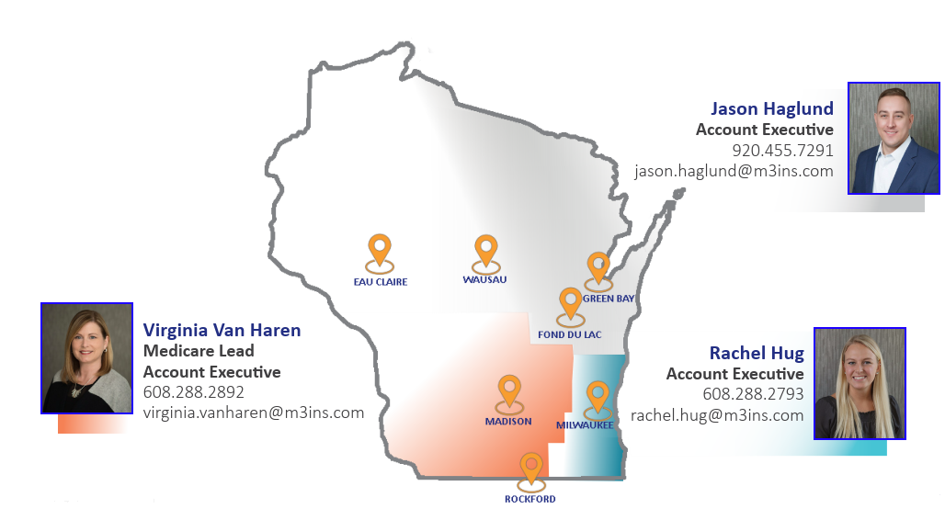
Medicare Insight & Guidance M3 Elevate (a division of M3 Insurance)
Medicare Advantage
Medicare Supplement Insurance
Prescription Drug Plans
Notes:
Sellars recognizes some of you may be getting solicited for Medicare-related products and services which can quickly become overwhelming. To help you evaluate your options and understand your out-of-pocket costs, we have asked our Medicare specialist, M3 Elevate, to provide support. This benefit is paid for by Sellar’s and available to anyone nearing retirement, turning 65, or just looking for general information about Medicare.
You may contact the respective account executive assigned to your geographic location to further explore your options. This includes comparing Sellars health insurance plans against potential Medicare options. You may also share this resource with your friends and family. Those who reside outside of the reflected service areas will be referred to a trusted partner of M3 Elevate.

Slide 49

Thank you

