Slide 1



Benefits
Overview
2025

Slide 2
Open Enrollment
Annual Opportunity to Add, Change, Drop or Waive Coverage
This is an ACTIVE Open Enrollment
Changes go into effect on: 1/1/2025
Mid-year elections or changes require a qualified life event
Open Enrollment begins on November 22nd

Slide 3







2025 Benefit Offerings
Medical – Quartz
HRA & FSA – Employee Benefits Corporation
Dental – Delta Dental of Wisconsin
Vision – Delta Dental of Wisconsin (DeltaVision)
Life & Long-Term Disability – The Hartford
Short Term Disability - Principal
Voluntary Benefits – The Hartford
Employee Assistance Program (EAP) – Gunderson Health System

Slide 4

Medical Plan
HMO Medical Plan | In-Network Benefits
Deductible | $6,500 (HRA pays $3,500) $13,000 (HRA pays $7,000)
Coinsurance | 80%/20%
Out of Pocket Maximum* | $7,850 $15,700
Hosp/Surg/Lab/X-Ray | Deductible/Coinsurance
Preventive Exams | Covered 100%
PCP Visits | Deductible/Coinsurance
Specialist Visit | Deductible/Coinsurance
Urgent Care | Deductible/Coinsurance
Emergency Room | Deductible/Coinsurance
Prescription Drugs | Value Tiers 1 & 2: $5/$35 $10/$35/$60/$200
*HRA lowers the out-of-pocket maximum

Slide 5

Medical Plan Premiums
Medical Plan
Hours Worked Prior Quarter | Per Pay Period Rate (Single) | Per Pay Period Rate (Single + 1) | Per Pay Period Rate (Family)
0 – 52 | $328.24 | $623.65 | $867.29
54 – 58 | $132.94 | $296.24 | $411.96
60 – 68 | $105.04 | $294.46 | $346.92
70 – 78 | $49.24 | $155.91 | $216.82
80 + | $43.66 | $146.56 | $203.81

Slide 6
Health Reimbursement Arrangement
In addition to the medical plan, the company also offers an additional benefit called the Health Reimbursement Arrangement (HRA) that offsets a portion of your deductible and/or out-of-pocket costs.
The HRA is a tax-advantaged plan that runs adjacent to the medical plan. It is provided to high-deductible health plan participants. It is intended to offer a safety net to help protect you from large healthcare expenses. The company sets aside funds to provide tax-free reimbursements to plan participants as eligible medical expenses are incurred.
Health Reimbursement Arrangement (HRA)
 | Annual Deductible | HRA Reimbursement | Net Deductible
 | Health Insurance Carrier | Company Funded Amount | Your Responsibility
Single | $6,500 | $3,500* | $3,000
Family | $13,000 | $7,000* | $6,000
The Company HRA:
Reduces your out-pocket costs
Reimbursements are tax-free
Empowers you to engage in your health care

Slide 7
Flexible Spending Account
You have the opportunity to save pre-tax money on your healthcare by participating in the Flexible Spending Account (FSA) that Bethany St. Joseph offers.
IMPORTANT!
You must use the funds in your FSA prior to the end of the plan year.
The plan will allow you to rollover $660 into the following plan year.
Runout Period is 3 months long.
Unused funds will be forfeited!
General Purpose FSA
Medical, Dental & Vision Expenses – Your FSA dollars can be used for office visits, services, and materials. Enrolling in the general-purpose FSA will make you and/or your spouse ineligible to contribute to an HSA.
Dependent Care FSA
Use Tax Free Dollars for dependent care expenses.
2025 Annual IRS Contribution Limit:
Health Care General Purpose | $3,300
Dependent Care FSA | $5,000

Slide 8

Dental Plan
Benefits | Delta Dental Premier Network
Deductible (single/family) | $50/$150
Annual Benefit Maximum | $1,000
Preventive Services | 100% Covered
Basic Services | 80% after Deductible
Major Services | 50% after Deductible
Orthodontic Services Adults & Children | 50% up to $1,500 lifetime benefit maximum

Slide 9

Dental Plan Premiums
Dental Plan
Hours Worked Prior Quarter | Per Pay Period Rate (Single) | Per Pay Period Rate (Family)
0 – 52.99 | $15.83 | $50.46
53 – 59.99 | $8.07 | $35.62
60 – 69.99 | $6.97 | $33.51
70 – 79.99 | $4.75 | $29.27
80 + | $4.53 | $28.84

Slide 10

Vision Plan
Benefits | In-Network | Out of Network
Vision Exam (Every 12 months) | $10 copay | Up to $35 reimbursement
Frames (Every 24 months) | $130 allowance + 20% off balance | Up to $65 reimbursement
Standard Lenses (Every 12 months) | $10 copay | Up to $25 reimbursement
Contact Lenses (Every 12 months) | $120 allowance + 15% off balance | Up to $96 reimbursement

Slide 11

Vision Plan Premium
Vision Plan | Bi-Weekly Premiums
Employee | $2.73
Family | $6.80

Slide 12


Life/AD&D Insurance
Group Life/AD&D
Life/AD&D Benefit: $50,000
Update Beneficiary Information
Sponsored by Bethany St. Joseph
Voluntary Life/AD&D
You have the option to purchase additional life insurance. Total costs are calculated based on your age and the amount of coverage you are requesting.

Slide 13

Disability Insurance
Voluntary Short-Term Disability (STD) - Principal
Benefit | 60% of your weekly income to a maximum of $1,000 per week
Elimination Period | 14 days
Benefit Duration | 24 Weeks
Premium/cost: | Voluntary – See Benefit Guide
Long Term Disability (LTD) – The Hartford
Benefit | 60% of your monthly income to a maximum of $4,333 per month
Elimination Period | 180 days
Benefit Duration | Social Security Normal Retirement Age
Premium/cost: | Paid by Bethany St. Joseph

Slide 14
Required Hospital Indemnity Notice
IMPORTANT: This is a fixed indemnity policy,
NOT health insurance
This fixed indemnity policy may pay you a limited dollar amount if you're sick or hospitalized. You're still responsible for paying the cost of your care.
The payment you get isn't based on the size of your medical bill.
There might be a limit on how much this policy will pay each year.
This policy isn't a substitute for comprehensive health insurance.
Since this policy isn't health insurance, it doesn't have to include most Federal consumer protections that apply to health insurance.
Looking for comprehensive health insurance?
Visit HealthCare.gov or call 1-800-318-2596 (TTY: 1-855-889-4325) to find health coverage options.
To find out if you can get health insurance through your job, or a family member's job, contact the employer.
Questions about this policy?
For questions or complaints about this policy, contact your State Department of Insurance. Find their number on the National Association of Insurance Commissioners' website (naic.org) under "Insurance Departments."
If you have this policy through your job, or a family member's job, contact the employer.

Slide 15

Voluntary Worksite Benefits
Voluntary Accident Insurance
Your medical insurance will cover some of the expenses incurred from an accident, but you’ll be left to foot the bills for your copays and deductible. Those can add up fast, especially if you’re unable to work while you recover. That’s where accident insurance comes in. It helps protect your bank account from the out-of-pocket expenses that come with an injury, whether you’re coping with a broken arm or recovering from a serious car accident. Accidents such as Broken Bones, Torn Ligaments, Burns, Concussions, Lacerations and much more could qualify for a cash benefit under the Voluntary Accident Insurance policy.
Voluntary Critical Illness Insurance
You may have medical insurance. But that doesn’t mean you’re covered for all of the expenses resulting from a serious illness that you probably haven’t budgeted for. Things like copays, deductibles, loss of income, childcare and travel expenses. Critical Illness insurance helps fill the gap caused by these out-of-pocket costs, creating a financial safety net for you and your family. The critical illness policy provides the option to receive a lump sum cash benefit upon initial diagnosis of one the approved conditions. This plan is designed to provide financial peace of mind during times of medical distress.
Voluntary Hospital Indemnity Insurance
Hospital Indemnity insurance provides additional financial support when you need it most. This benefit will provide you with a cash reimbursement in the event you are admitted to the hospital as a result of a covered illness and/or injury. Since this benefit is paid directly to you, you are eligible to use the funds towards expenses that are not covered by your health insurance or every day living expenses!

Slide 16
Employee Assistance Program
Balancing your work and home life is not always easy, with Bethany St. Joseph's EAP program you don’t have to face life’s challenges alone.
You may be struggling with stress at work, seeking financial or legal advice, or coping with the death of a loved one. Maybe you just want to strengthen your relationship with your family. Your benefit offers assistance and support for all these concerns and more:
Depression
Marital Difficulties
Financial Concerns
Family Conflicts
Alcohol and Drug Problems
Work-Related Issues
Please call 608.775.4780 or 800.327.991
Or email eap@gundersonhealth.com

Slide 17

Additional Benefits
Retirement Account
Paid Leave
Voluntary Time Off
Tuition Reimbursement

Slide 18
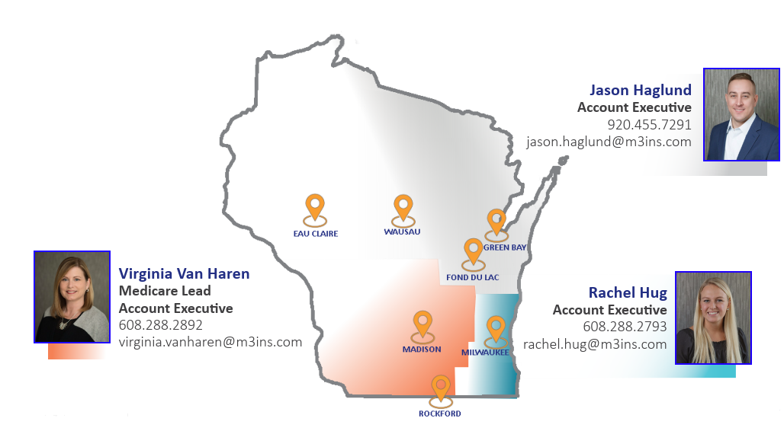
Medicare Insight & Guidance
M3 Elevate (a division of M3 Insurance)
Medicare Advantage
Medicare Supplement Insurance
Prescription Drug Plans
Notes:
Sellars recognizes some of you may be getting solicited for Medicare-related products and services which can quickly become overwhelming. To help you evaluate your options and understand your out-of-pocket costs, we have asked our Medicare specialist, M3 Elevate, to provide support. This benefit is paid for by Sellar’s and available to anyone nearing retirement, turning 65, or just looking for general information about Medicare.
You may contact the respective account executive assigned to your geographic location to further explore your options. This includes comparing Sellars health insurance plans against potential Medicare options. You may also share this resource with your friends and family. Those who reside outside of the reflected service areas will be referred to a trusted partner of M3 Elevate.

Slide 19

Thank you

